Slide 1

UNIT VI
TURING MACHINES AND COMPLEXITY

Slide 2
SYLLABUS
TURING MACHINES AND COMPLEXITY : Turing Machine Model, Representation of Turing Machines, Design of Turing Machines, The Model of Linear Bounded Automaton, Power of LBA, Variations of TM, Non-Deterministic Turing Machines, Halting Problem of Turing Machine, Post Correspondence Problem, Basic Concepts of Computability, Decidable and Undecidable languages, RECURSIVELY ENUMERABLE LANGUAGE, Computational Complexity: Measuring Time & Space Complexity, Power of Linear Bounded Automaton, Variations of Turing Machine, Cellular automaton

Slide 3
Introduction
A Turing Machine is an accepting device which accepts the languages (recursively enumerable set) generated by type 0 grammars.
It was invented in 1936 by Alan Turing.

Slide 4
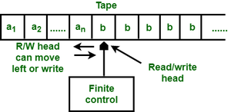
Design of Turing Machine
A Turing Machine (TM) is a mathematical model which consists of an infinite length tape divided into cells on which input is given.
It consists of a head which reads the input tape. A state register stores the state of the Turing machine.
After reading an input symbol, it is replaced with another symbol, its internal state is changed, and it moves from one cell to the right or left.
If the TM reaches the final state, the input string is accepted, otherwise rejected.

Slide 5
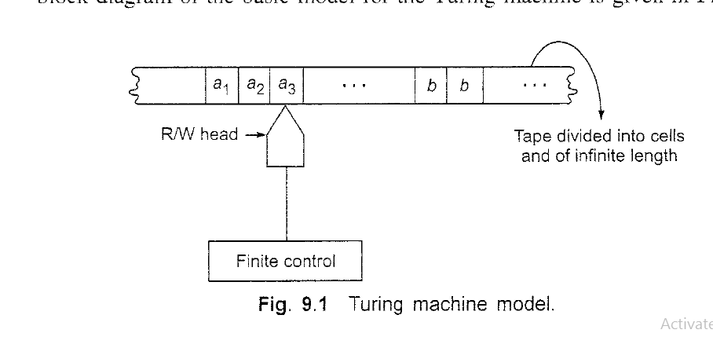

Slide 6
Definition
A TM can be formally described as a 7-tuple (Q, X, ∑, δ, q₀, B, F) where −
Q is a finite set of states
X is the tape alphabet
∑ is the input alphabet
δ is a transition function; δ : Q × X → Q × X × {Left_shift, Right_shift}.
q₀ is the initial state
B is the blank symbol
F is the set of final states

Slide 7
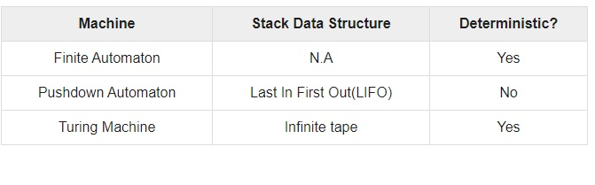
Comparison with the previous automaton

Slide 8
Example of Turing machine
Turing machine M = (Q, X, ∑, δ, q₀, B, F) with
Q = {q₀, q₁, q₂, q_{f}}
X = {a, b}
∑ = {1}
q₀ = {q₀}
B = blank symbol
F = {q_{f} }

Slide 9
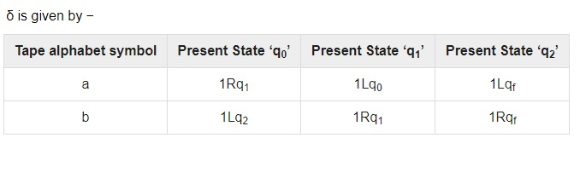
Here the transition 1Rq₁ implies that the write symbol is 1, the tape moves right, and the next state is q₁.
Similarly, the transition 1Lq₂ implies that the write symbol is 1, the tape moves left, and the next state is q₂.

Slide 10
Types of Turing Machine(Variation)
MultiTape
MultiHead
2way infinite TM
Non Deterministic
Deterministic
Multi Dimensional
Universal

Slide 11
Linear Bounded Automata
A linear bounded automaton is a multi-track non-deterministic Turing machine with a tape of some bounded finite length.
Length = function (Length of the initial input string, constant c)
Here,
Memory information ≤ c × Input information

Slide 12
The computation is restricted to the constant bounded area.
The input alphabet contains two special symbols which serve as left end markers and right end markers which mean the transitions neither move to the left of the left end marker nor to the right of the right end marker of the tape.

Slide 13
A linear bounded automaton can be defined as an 8-tuple (Q, X, ∑, q₀, ML, MR, δ, F) where −
Q is a finite set of states
X is the tape alphabet
∑ is the input alphabet
q₀ is the initial state
M_{L} is the left end marker
M_{R} is the right end marker where M_{R} ≠ M_{L}
δ is a transition function which maps each pair (state, tape symbol) to (state, tape symbol, Constant ‘c’) where c can be 0 or +1 or -1
F is the set of final states

Slide 14
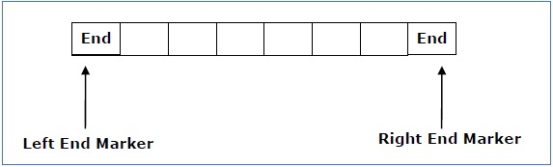
A deterministic linear bounded automaton is always context-sensitive and the linear bounded automaton with empty language is undecidable..

Slide 15
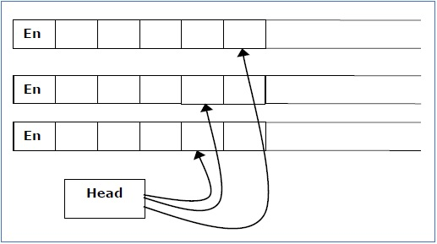
Multi-tape Turing Machine
Multi-tape Turing Machines have multiple tapes where each tape is accessed with a separate head.
Each head can move independently of the other heads. Initially the input is on tape 1 and others are blank.
At first, the first tape is occupied by the input and the other tapes are kept blank.
Next, the machine reads consecutive symbols under its heads and the TM prints a symbol on each tape and moves its heads.

Slide 16
A Multi-tape Turing machine can be formally described as a 6-tuple (Q, X, B, δ, q₀, F) where −
Q is a finite set of states
X is the tape alphabet
B is the blank symbol
δ is a relation on states and symbols where
δ: Q × X^{k} → Q × (X × {Left_shift, Right_shift, No_shift })^{k}
where there is k number of tapes
q₀ is the initial state
F is the set of final states
Note − Every Multi-tape Turing machine has an equivalent single-tape Turing machine.

Slide 17
Multi-track Turing Machine
Multi-track Turing machines, a specific type of Multi-tape Turing machine, contain multiple tracks but just one tape head reads and writes on all tracks.
Here, a single tape head reads n symbols from n tracks at one step.
It accepts recursively enumerable languages like a normal single-track single-tape Turing Machine accepts.

Slide 18
A Multi-track Turing machine can be formally described as a 6-tuple (Q, X, ∑, δ, q₀, F) where −
Q is a finite set of states
X is the tape alphabet
∑ is the input alphabet
δ is a relation on states and symbols where
δ(Q_{i}, [a₁, a₂, a₃,....]) = (Q_{j}, [b₁, b₂, b₃,....], Left_shift or Right_shift)
q₀ is the initial state
F is the set of final states
Note − For every single-track Turing Machine S, there is an equivalent multi-track Turing Machine M such that L(S) = L(M).

Slide 19
Non-Deterministic Turing Machine
In a Non-Deterministic Turing Machine, for every state and symbol, there are a group of actions the TM can have.
So, here the transitions are not deterministic. The computation of a non-deterministic Turing Machine is a tree of configurations that can be reached from the start configuration.

Slide 20
An input is accepted if there is at least one node of the tree which is an accept configuration, otherwise it is not accepted.
If all branches of the computational tree halt on all inputs, the non-deterministic Turing Machine is called a Decider and if for some input, all branches are rejected, the input is also rejected.

Slide 21
A non-deterministic Turing machine can be formally defined as a 6-tuple (Q, X, ∑, δ, q₀, B, F) where −
Q is a finite set of states
X is the tape alphabet
∑ is the input alphabet
δ is a transition function;
δ : Q × X → P(Q × X × {Left_shift, Right_shift}).
q₀ is the initial state
B is the blank symbol
F is the set of final states

Slide 22
POLLING QUESTIONS
Which of the functions can a turing machine not perform?
a) Copying a string
b) Deleting a symbol
c) Accepting a pal
d) Inserting a symbol
Notes:
d

Slide 23
2. A Language L may not be accepted by a Turing Machine if:
a) It it is recursively ennumerable
b) It is recursive
c) L can be ennumerated by some turing machine
d) None of the mentioned
Notes:
b

Slide 24
3. Turing machine (TM) is more powerful than FMS (Finite State Machine) because
A. Tape movement is confined to one direction
B. It has no finite state
C. It has the capability to remember arbitrarily long sequences of input symbols
D.none of these
Notes:
c

Slide 25
Which of the following automata takes queue as an auxiliary storage?
Finite automata
Push down automata
Turing machine
All of the mentioned
Notes:
c

Slide 26
A context free grammar can be recognized by
Push down automata
2 way linearly bounded automata
both a and b
None of the mentioned
Notes:
c

Slide 27
A linear bounded automaton(LBA) is represented as an 8-tuple (Q, X, ∑, q₀, ML, MR, δ, F). What does X denote?
Initial Symbol
Tape symbol
Blank Symbol
None of these
Notes:
b

Slide 28
Universal TM
In computer science, a universal Turing machine(UTM) is a Turing machine that can simulate an arbitrary Turing machine on arbitrary input.
The universal machine essentially achieves this by reading both the description of the machine to be simulated as well as the input thereof from its own tape.

Slide 29
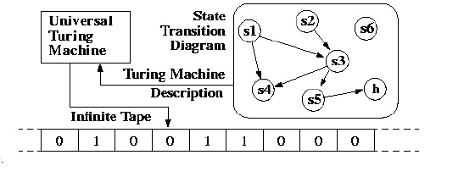
UTM along with the input on the tape, takes in the description of a machine M.
The UTM can go on then to simulate M on the rest of the contents of the input tape.
A universal Turing machine can thus simulate any other machine.

Slide 30
Turing Machine Halting Problem
Input − A Turing machine and an input string w.
Problem − Does the Turing machine finish computing of the string w in a finite number of steps? The answer must be either yes or no.
Proof − At first, we will assume that such a Turing machine exists to solve this problem and then we will show it is contradicting itself. We will call this Turing machine as a Halting machine that produces a ‘yes’ or ‘no’ in a finite amount of time. If the halting machine finishes in a finite amount of time, the output comes as ‘yes’, otherwise as ‘no’.

Slide 31
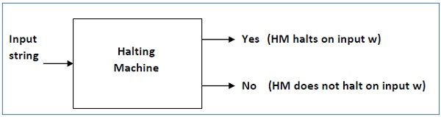
The following is the block diagram of a Halting machine −

Slide 32
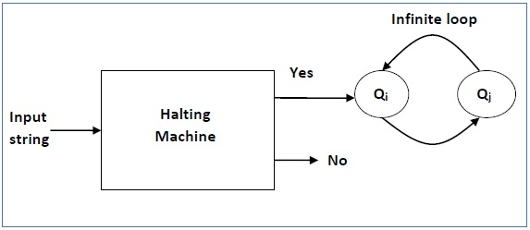
Now we will design an inverted halting machine (HM)’ as −
If H returns YES, then loop forever.
If H returns NO, then halt.
The following is the block diagram of an ‘Inverted halting machine’ −
Further, a machine (HM)₂ which input itself is constructed as follows −
If (HM)₂ halts on input, loop forever.
Else, halt.
Here, we have got a contradiction. Hence, the halting problem is undecidable.

Slide 33
Halting Problem
In computability theory, the halting problem is the problem of determining, from a description of an arbitrary computer program and an input, whether the program will finish running, or continue to run forever.

Slide 34
The problem is to determine, given a program and an input to the program, whether the program will eventually halt when run with that input.
There are no resource limitations on the amount of memory or time required for the program's execution;
It can take arbitrarily long and use an arbitrary amount of storage space before halting.
The question is simply whether the given program will ever halt on a particular input.

Slide 35
For example, in pseudocode, the program
while (true) continue
does not halt; rather, it goes on forever in an infinite loop. On the other hand, the program
print "Hello, world!“
does halt.
While deciding whether these programs halt is simple, more complex programs prove problematic.

Slide 36
Alan Turing proved in 1936 that a general algorithm to solve the halting problem for all possible program-input pairs cannot exist.

Slide 37
POLLING QUESTIONS
1. A turing machine that is able to simulate other turing machines:
a) Nested Turing machines
b) Universal Turing machine
c) Counter machine
d) None of the mentioned
Notes:
b

Slide 38
2. If d is not defined on the current state and the current tape symbol, then the machine ______
a) does not halts
b) halts
c) goes into loop forever
d) none of the mentioned
Notes:
b

Slide 39
3. Which of the following are the models equivalent to Turing machine?
a) Multi tape turing machine
b) Multi track turing machine
c) Register machine
d) All of the mentioned
Notes:
d

Slide 40
4. Which of the following is true for The Halting problem?
a. It is recursively ennumerable
b. It is undecidable
c. both a and b
d. None of the mentioned
Notes:
c

Slide 41
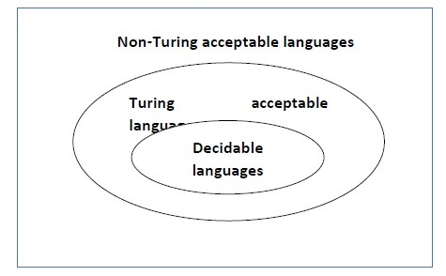
Language Decidability
A language is called Decidable or Recursive if there is a Turing machine which accepts and halts on every input string w. Every decidable language is Turing-Acceptable.

Slide 42
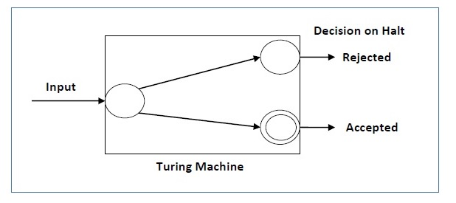
A decision problem P is decidable if the language L of all yes instances to P is decidable.
For a decidable language, for each input string, the TM halts either at the accept or the reject state as depicted in the following diagram −

Slide 43
Example 1
Problem: Find out whether the following problem is decidable or not − Is a number ‘m’ prime?
Solution: Prime numbers = {2, 3, 5, 7, 11, 13, …………..}
Divide the number ‘m’ by all the numbers between ‘2’ and ‘√m’ starting from ‘2’.
If any of these numbers produce a remainder zero, then it goes to the “Rejected state”, otherwise it goes to the “Accepted state”. So, here the answer could be made by ‘Yes’ or ‘No’.
Hence, it is a decidable problem.

Slide 44
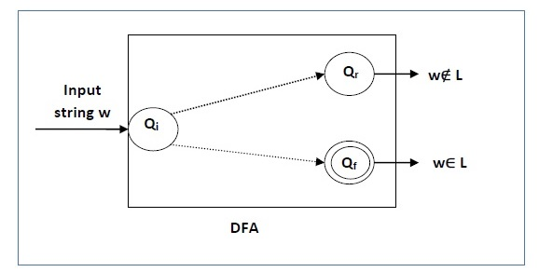
Example 2
Problem: Given a regular language L and string w, how can we check if w ∈ L?
Solution: Take the DFA that accepts L and check if w is accepted

Slide 45
Some more decidable problems are −
Does DFA accept the empty language?
Is L₁ ∩ L₂ = ∅ for regular sets?
Note −
If a language L is decidable, then its complement L' is also decidable
If a language is decidable, then there is an enumerator for it.

Slide 46
Undecidable Languages
For an undecidable language, there is no Turing Machine which accepts the language and makes a decision for every input string w (TM can make decision for some input string though).
A decision problem P is called “undecidable” if the language L of all yes instances to P is not decidable.
Undecidable languages are not recursive languages, but sometimes, they may be recursively enumerable languages.

Slide 47
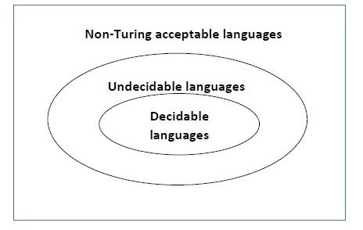

Slide 48
Example
The halting problem of Turing machine
The mortality problem
The mortal matrix problem
The Post correspondence problem, etc.

Slide 49
Conclusion
A problem is said to be Decidable if we can always construct a corresponding algorithm that can answer the problem correctly.
A problem is said to be a Decidable problem if there exists a corresponding Turing machine which halts on every input with an answer- yes or no.

Slide 50
The problems for which we can’t construct an algorithm that can answer the problem correctly in finite time are termed as Undecidable Problems.

Slide 51
POLLING QUESTIONS
1. A language L is said to be ____________ if there is a turing machine M such that L(M)=L and M halts at every point.
a) Turing acceptable
b) decidable
c) undecidable
d) none of the mentioned
Notes:
b

Slide 52
2. The problems which have no algorithm, regardless of whether or not they are accepted by a turing machine that fails to halts on some input are referred as:
a) Decidable
b) Undecidable
c) Computable
d) None of the mentioned
Notes:
b

Slide 53
3.Recursive languages are also known as:
a) decidable
b) undecidable
c) sometimes decidable
d) none of the mentioned
Notes:
a

Slide 54
4. Which of the following was not a part of Chomsky hierarchy ?
a) Context sensitive grammar
b) Unrestricted grammar
c) Recursive grammar
d) None of the mentioned
Notes:
c

Slide 55
5. Decidable can be taken as a synonym to:
a) recursive
b) non recursive
c) recognizable
d) none of the mentioned
Notes:
a

Slide 56
Computational Complexity
In computer science, the computational complexity or simply complexity of an algorithm is the amount of resources required to run it. Particular focus is given to time and memory requirements.

Slide 57
Measuring Time Complexity
Time complexity of an algorithm signifies the total time required by the program to run till its completion.
The time complexity of algorithms is most commonly expressed using the big O notation. It's an asymptotic notation to represent the time complexity.
Time Complexity is most commonly estimated by counting the number of elementary steps performed by any algorithm to finish execution.

Slide 58
Measuring Space Complexity
Space complexity of an algorithm represents the amount of memory space needed the algorithm in its life cycle.
Space needed by an algorithm is equal to the sum of the following two components
A fixed part that is a space required to store certain data and variables (i.e. simple variables and constants, program size etc.), that are not dependent of the size of the problem.
A variable part is a space required by variables, whose size is totally dependent on the size of the problem. For example, recursion stack space, dynamic memory allocation etc.

Slide 59
Space Time Tradeoff
In computer science, a space-time or time-memory tradeoff is a way of solving a problem or calculation in less time by using more storage space (or memory), or by solving a problem in very little space by spending a long time.
Most computers have a large amount of space, but not infinite space.

Slide 60
A space-time tradeoff can be used with the problem of data storage.
If data is stored uncompressed, it takes more space but less time than if the data were stored compressed.

Slide 61
POLLING QUESTIONS
The class of recursively enumerable language is known as:
a) Turing Class
b) Recursive Languages
c) Universal Languages
d) RE
Notes:
d

Slide 62
Which of the following statements are false?
a) Every recursive language is recursively enumerable
b) Recursively enumerable language may not be recursive
c) Recursive languages may not be recursively enumerable
d) None of the mentioned
Notes:
c

Slide 63
A Turing machine operates over:
a) finite memory tape
b) infinite memory tape
c) depends on the algorithm
d) none of the mentioned
Notes:
b

Slide 64
Turing machine can be represented using the following tools:
a) Transition graph
b) Transition table
c) Queue and Input tape
d) All of the mentioned
Notes:
d

Slide 65
X is a simple mathematical model of a computer. X has unrestricted and unlimited memory. X is a FA with R/W head. X can have an infinite tape divided into cells, each cell holding one symbol.
Name X?
a) Push Down Automata
b) Non deterministic Finite Automata
c) Turing machines
d) None of the mentioned
Notes:
c

Slide 66
Which of the following statements is/are true?
a) Every multitape turing machine has its equivalent single tape turing machine
b) Every multitape turing machine is an abstract machine
c) Both (a) and (b)
d) None of the mentioned
Notes:
c

Slide 67
Which of the following is/are a basic TM equivalent to?
a) Multitrack TM
b) Multitape TM
c) Non-deterministic TM
d) All of the mentioned
Notes:
d

Slide 68
Cellular Automata
A cellular automaton (pl. cellular automata, abbrev. CA) is a discrete model of computation studied in automata theory.

Slide 69
A cellular automaton consists of a regular grid of cells, each in one of a finite number of states, such as on and off.
The grid can be in any finite number of dimensions. For each cell, a set of cells called its neighborhood is defined relative to the specified cell.

Slide 70
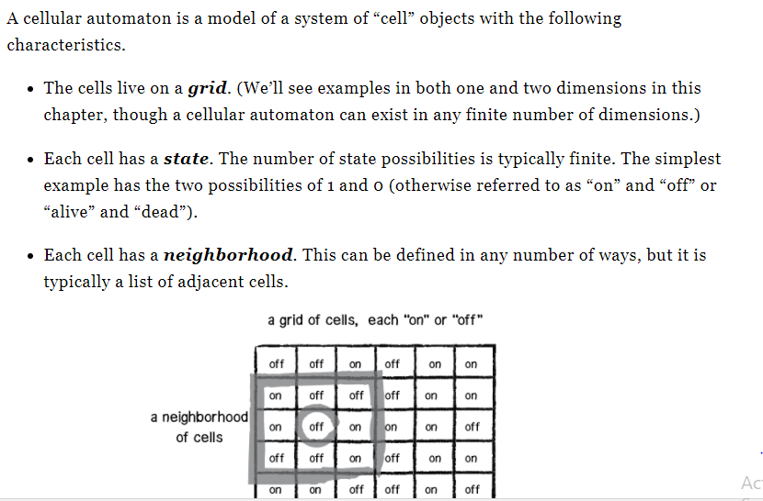

Slide 71
POLLING QUESTIONS
Cellular automata produce
a) exhaustive patterns
b) exhaustive pseudo random patterns
c) random patterns
d) pseudo random patterns
Notes:
d

Slide 72
A space-time or time-memory tradeoff is a way of solving a problem or calculation in:
Less time
More time
Both a or b
None of these
Notes:
c

Slide 73
In cellular automata, the grid can have _______no of dimensions
Infinite
Finite
Both a and b
None of these
Notes:
b

Slide 74
Space needed by an algorithm is equal to____
a)Fixed part
b) Variable part
c) Both a and b
d) None of these
Notes:
c

